Slide 1


Container Terminal
Operation
Apasaja Pte. Ltd.

Slide 2


Table of contents
01
04
Introduction
SQL Demo
02
ERD & Schema
05
Checking Constraint
03
Populate data
06
Enforcing Constraint

Slide 3

01
Introduction

Slide 4
Group 8
Bryan Salim
Vincent Aurellio Budianto
Faldho Wiriananda Ho
Matthew Antonia Wijaya
Khoo Xin Zhen

Slide 5
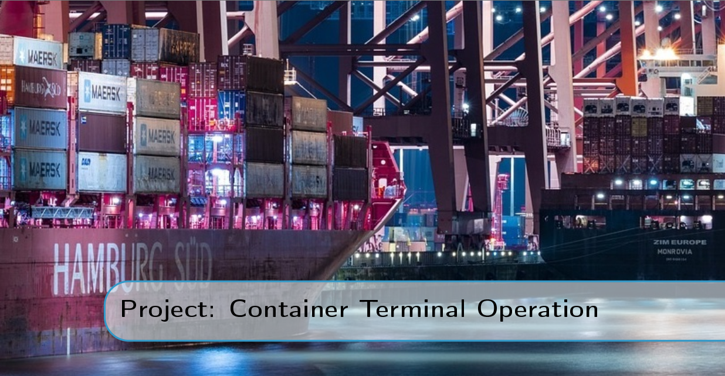
Project Overview

Slide 6
02
ERD & Schema

Slide 7
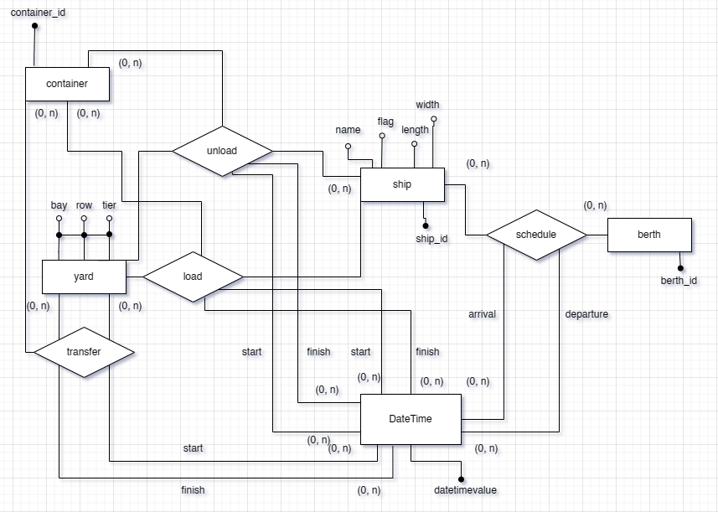
ERD

Slide 8
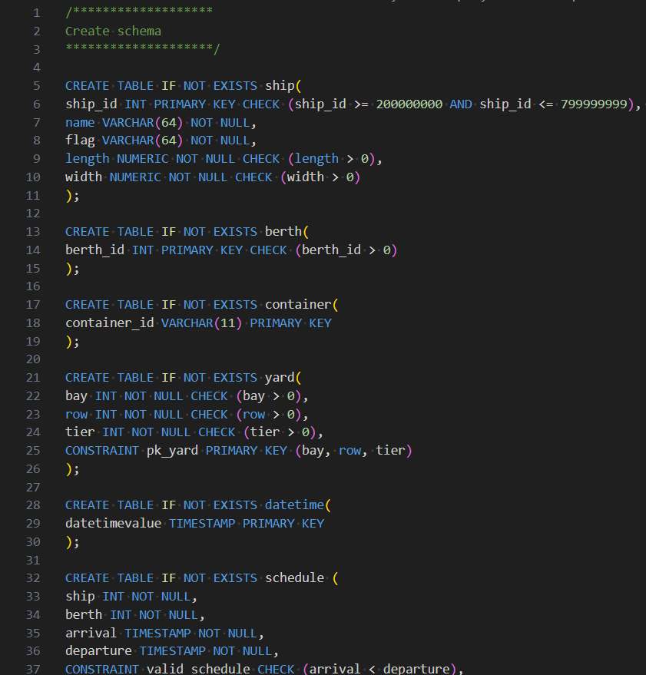
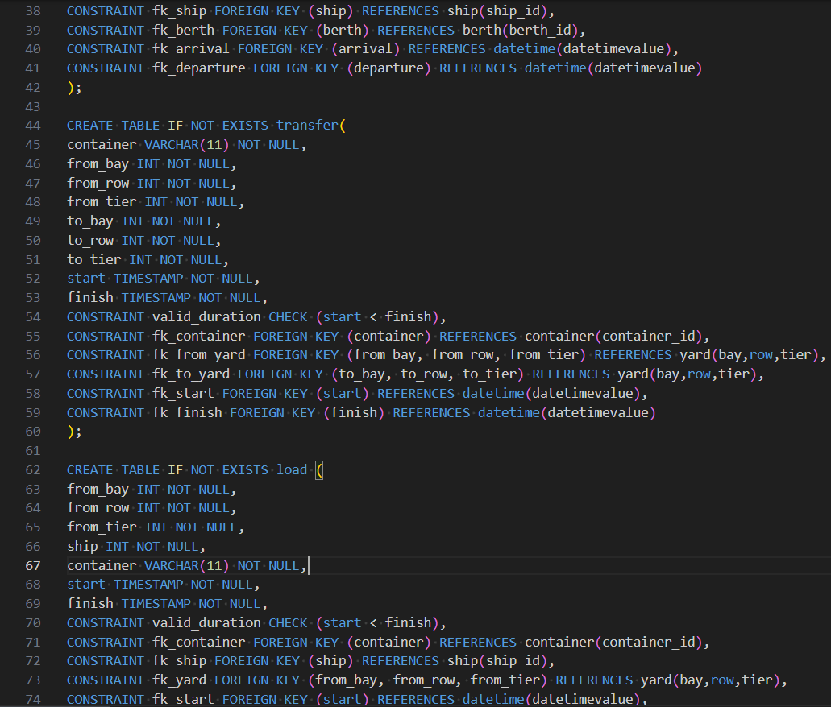
Schema

Slide 9
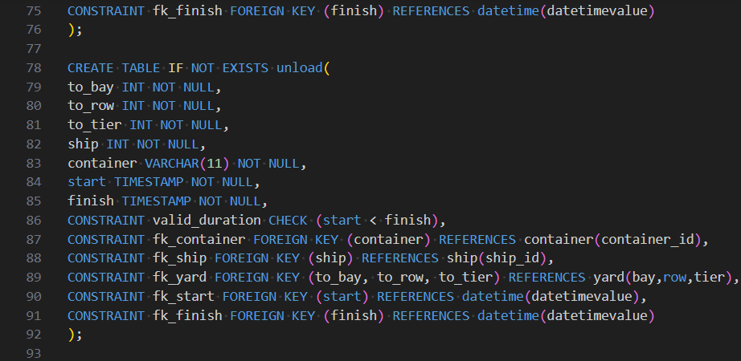
Schema

Slide 10
03
Populating Data

Slide 11
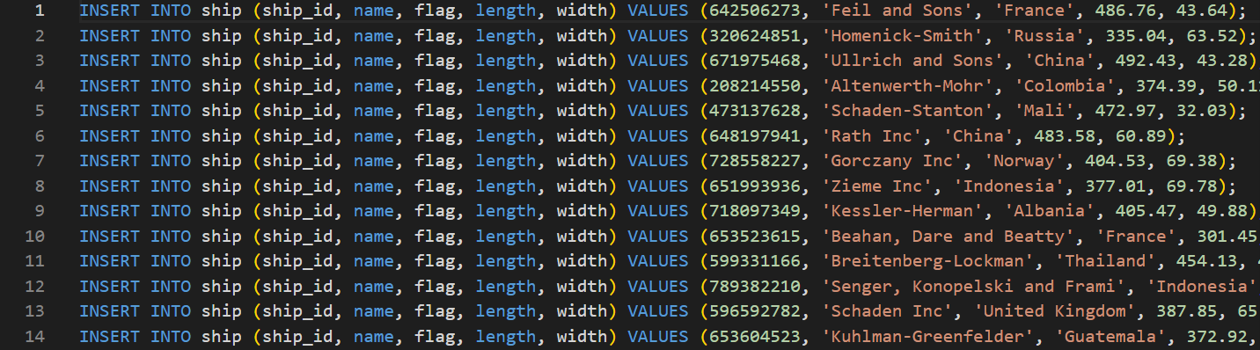
SQL Code
Inserting data into table

Slide 12
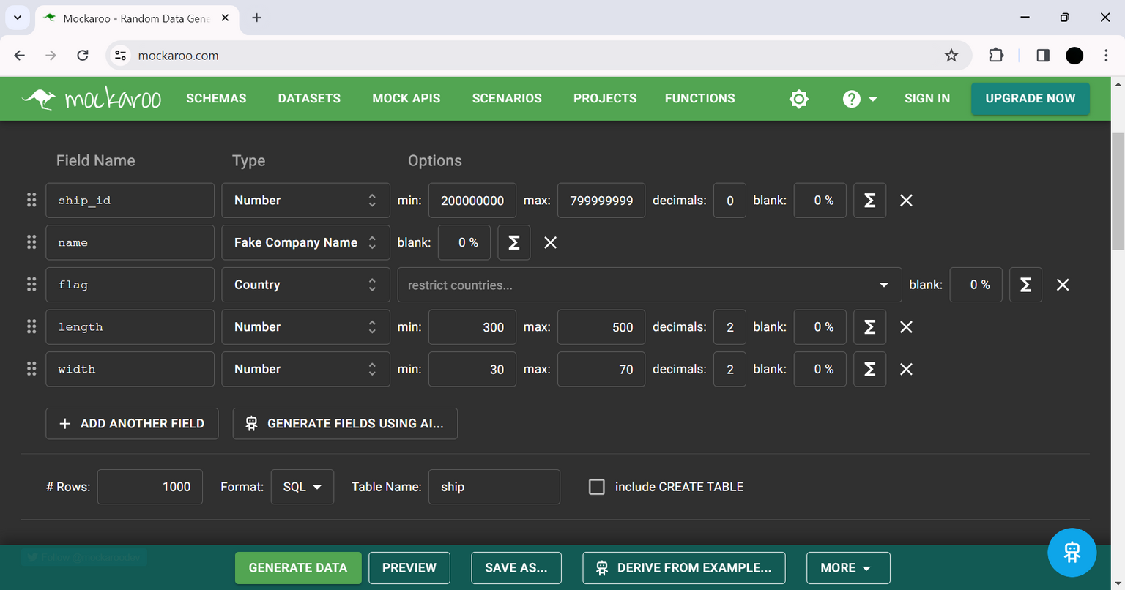
Generating mock data
1. Mockaroo
source: mockaroo.com

Slide 13
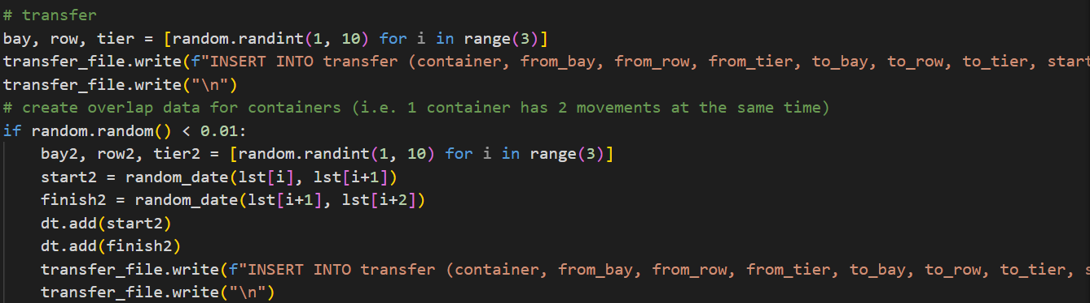
Generating mock data
2. Python

Slide 14
04
SQL Demo

Slide 15


Table manipulation demo
Overview of demonstration objectives: How to manipulate values in the database tables.
Scenario:
'Garuda Kencana' arrives from Indonesia at Persingahan terminal with container 'ABC' bound for Vietnam.
'ABC' container to be transferred to 'Naga Hitam' for onward journey.
Notes:
In this demonstration, we'll illustrate how to add, delete, or update values in our tables. Imagine a scenario where we want to add a ship named 'Garuda Kencana' arrives from Indonesia at the Persingahan terminal, carrying a container labeled 'ABC' destined for Laos. Soon, the container is scheduled to be transferred to another ship, 'Naga Hitam,' set to depart in a few days.

Slide 16
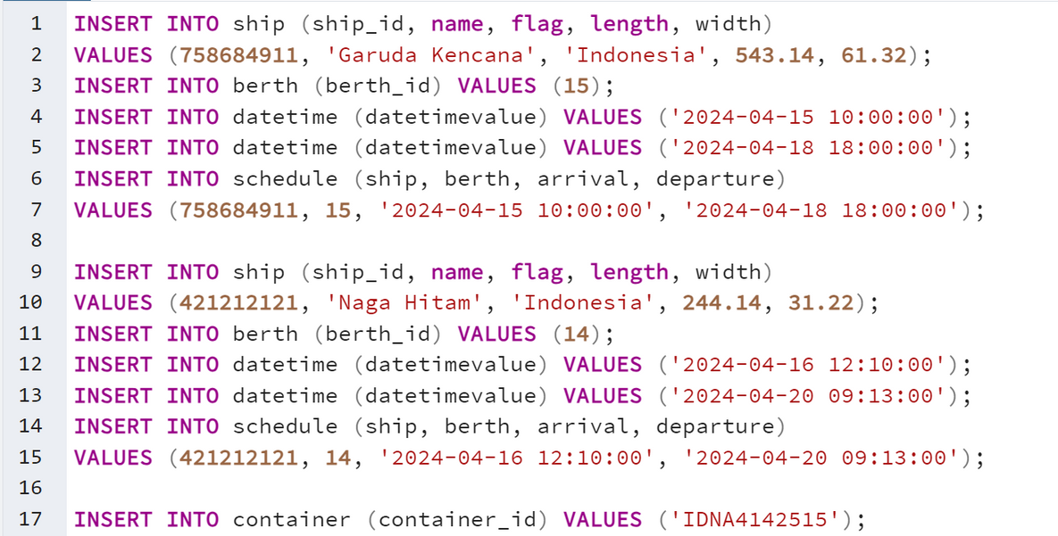


Table manipulation demo
Adding all entity data, such as ship, berth, container, datetime table that involved
Adding the ship 'Garuda Kencana' from Indonesia and scheduling its arrival and departure times at berth 15.
Adding the ship 'Naga Hitam' from Indonesia and scheduling its arrival and departure times at berth 14.
Adding the container
Notes:
Assume Garuda Kencana will arrive at berth 5

Slide 17
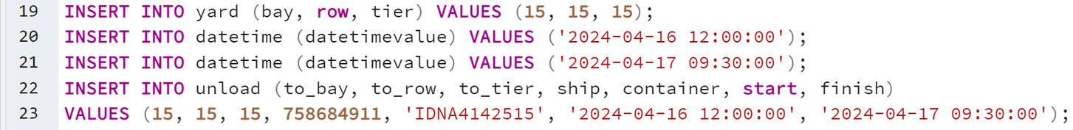
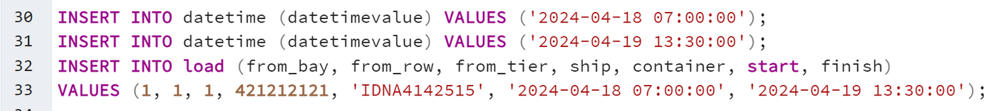
Table manipulation demo
Unload the Container
Transfer the container
Load the container
Notes:
Assume Garuda Kencana will arrive at berth 5

Slide 18
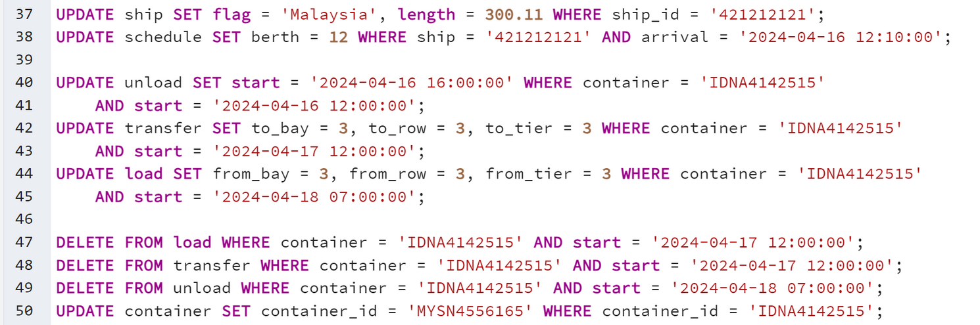
Table manipulation demo
Updating Value
Notes:
Assume Garuda Kencana will arrive at berth 5

Slide 19
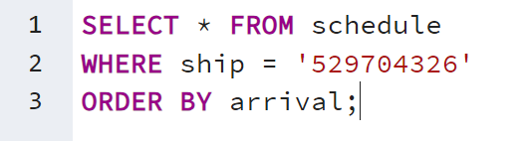
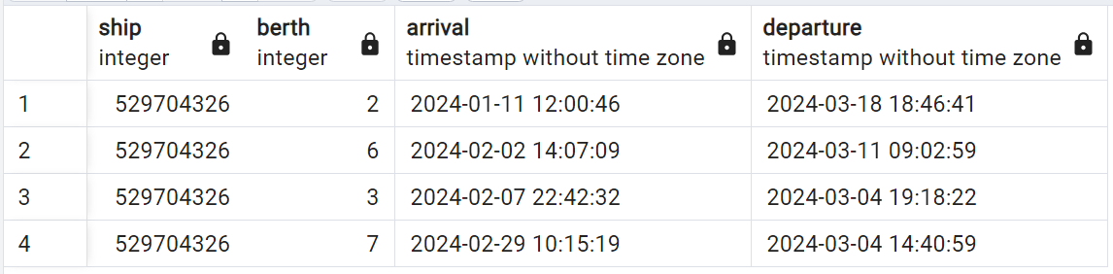
Querying the table
Given a ship, retrieve a log of this ship's schedules
result :
Notes:
Assume Garuda Kencana will arrive at berth 5

Slide 20
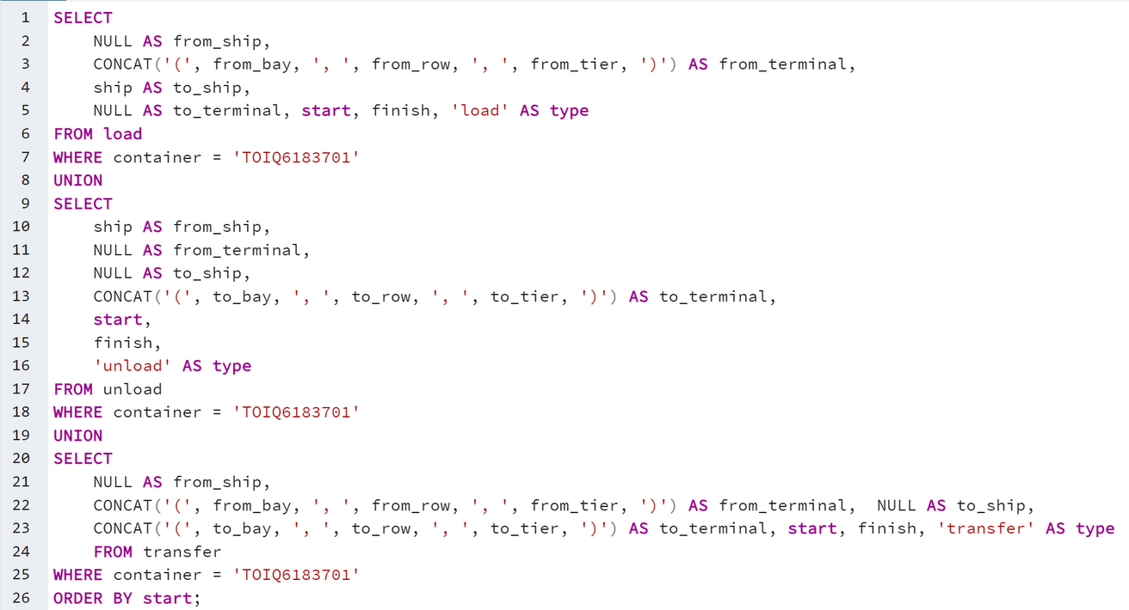
Querying the table
A container movement log
Notes:
Assume Garuda Kencana will arrive at berth 5

Slide 21
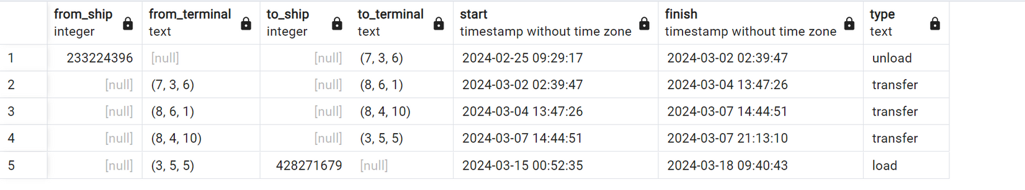
Querying the table
A container movement log, result :
Notes:
Assume Garuda Kencana will arrive at berth 5

Slide 22
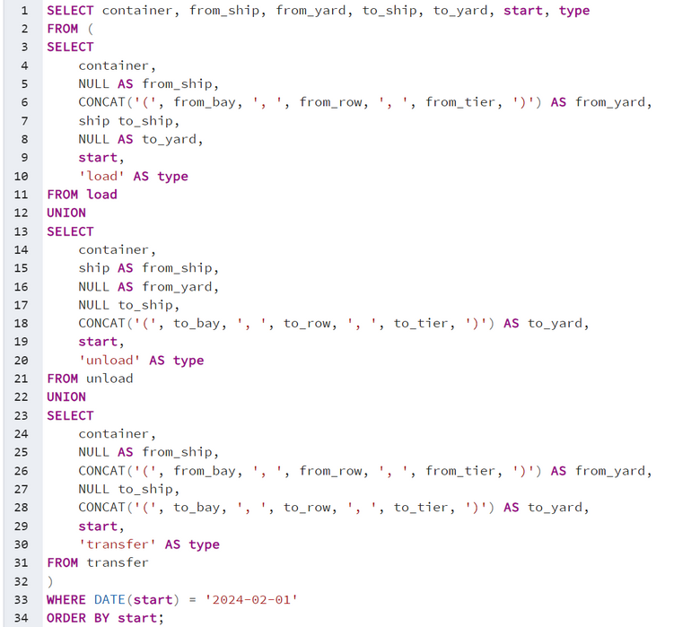
Querying the table
Generate report of all containers' movement in a day
Notes:
Assume Garuda Kencana will arrive at berth 5

Slide 23
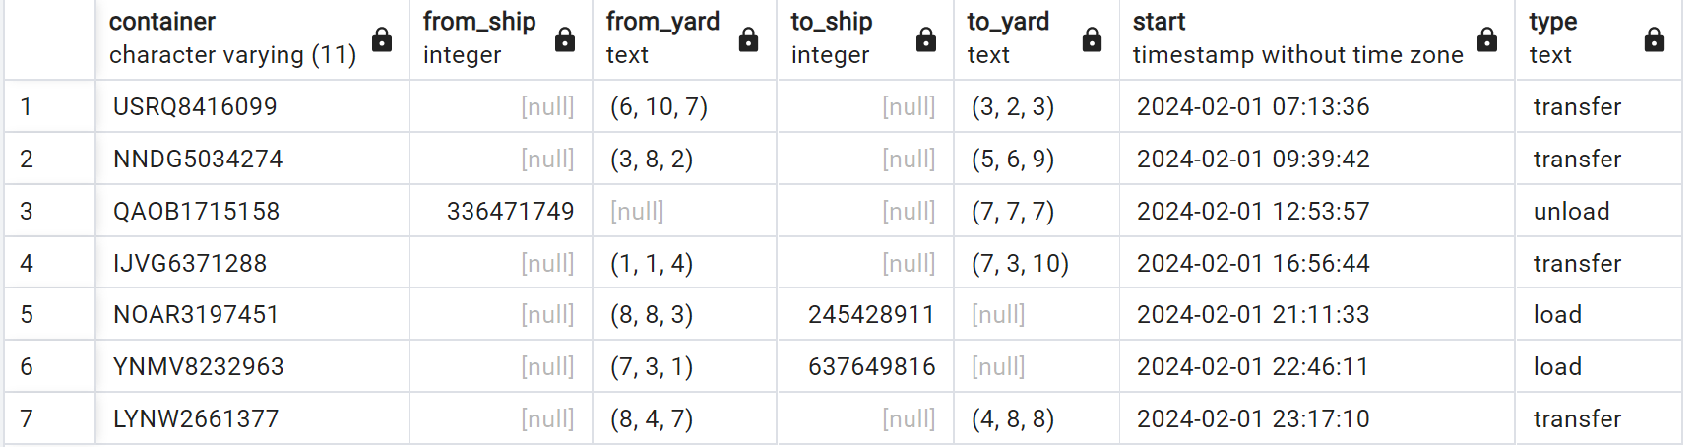
Querying the table
Generate report of all containers' movement in a day, result :
Notes:
Assume Garuda Kencana will arrive at berth 5

Slide 24
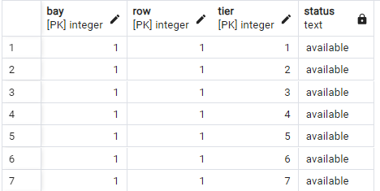
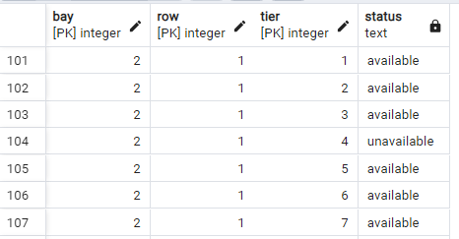
Querying the table
View yard availability status
Note : assume yard under loading process to be unavailable and yard under unloading to be available. Meanwhile, if containers transferred from one yard to other yard, the former is assumed to be available while the latter is assumed to be unavailable
Notes:
Thank you faldho, I will now present on the queries that display all statuses that is happening in the terminal.
This table check the available yard location at a given time

Slide 25
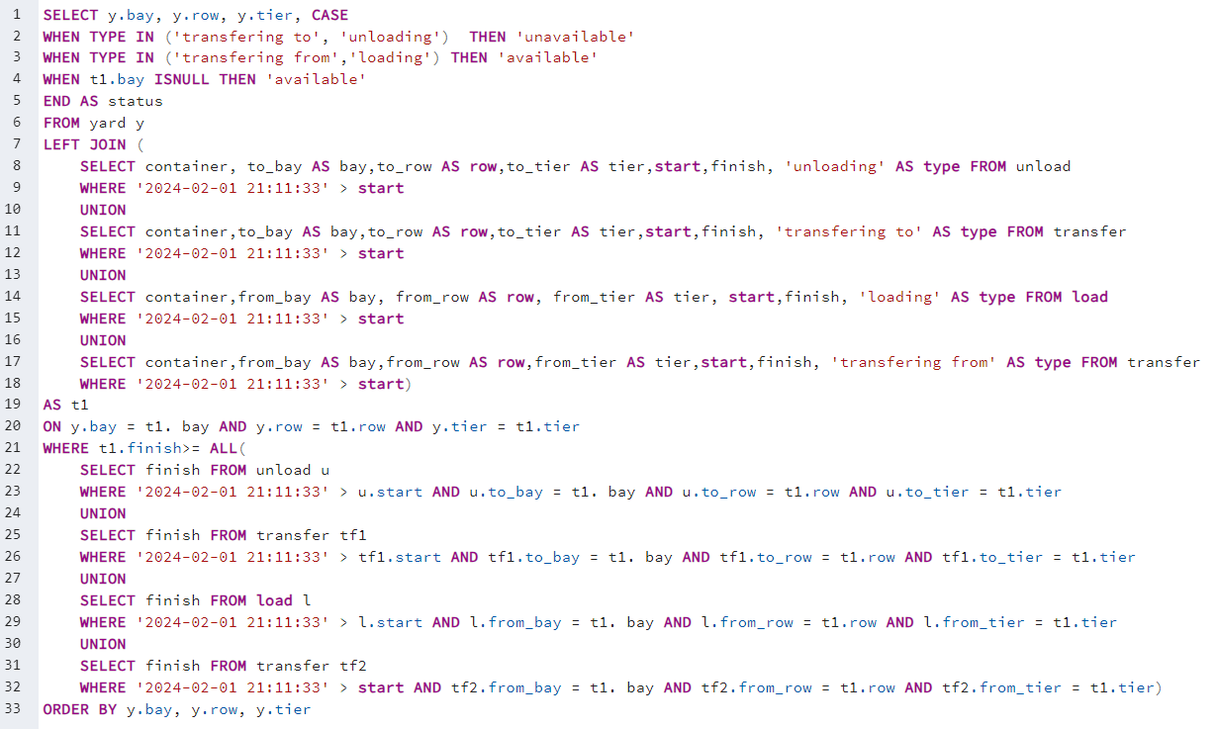
Notes:
This is the query used, we combined load, unload and transfer to get all the movement records then take the last movement of each yard coordinate. We filtered out the start to be less than the input timestamp. Then if the yard is not in the movement table, it means the yard is vacant/available

Slide 26
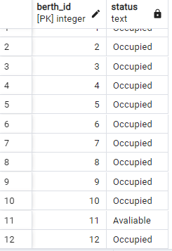
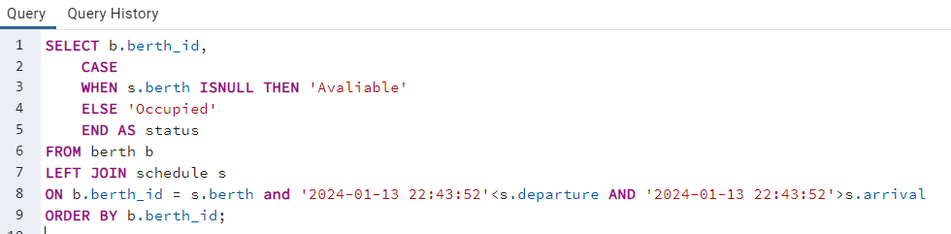
Querying the table
View berth availability status
Note : ‘2024-01-13 22:43:52’ sample input datetime
Notes:
The query will get the availability of berth in a given timestamp. If a ship is docked during the timestamp, it will indicate occupied otherwise its available

Slide 27
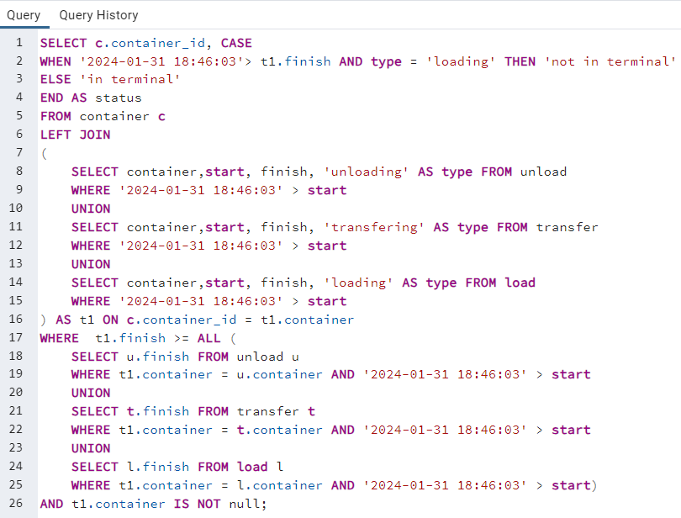
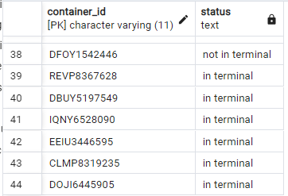
Querying the table
View container is in terminal or not
Note : '2024-01-31 18:46:03' sample input datetime
Notes:
This query will give the status of all containers, whether they are in terminal or not. We combine transfer, load and unload to be in one movement record.
Containers that undergoing loading process are assumed to be still in terminal while those that has been loaded to a ship are considered to be no longer in terminal.

Slide 28
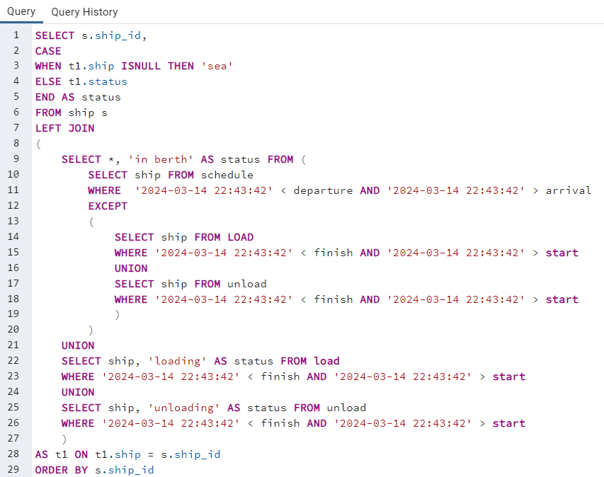
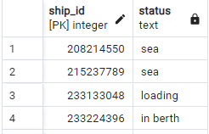
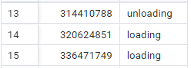
Querying the table
View ship status
Note : '2024-03-14 22:43:42' sample input datetime
Notes:
This query will display ships status, whether they are in berth, undergoing unloading, loading or at sea. Ships that are docked but not doing any activity are labelled in berth.

Slide 29
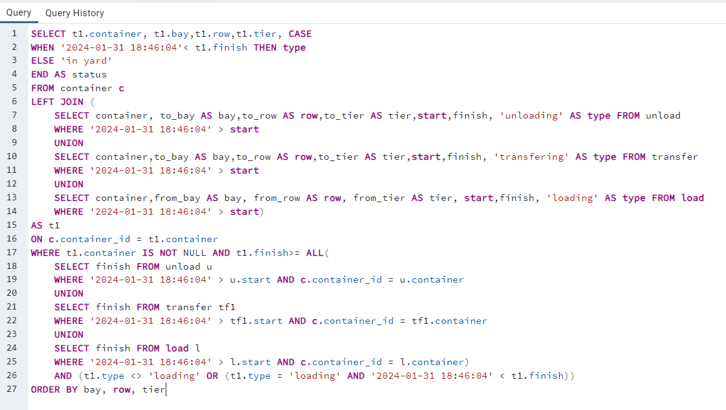
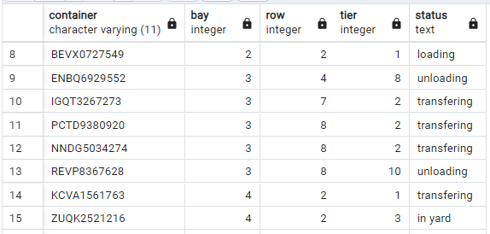
Querying the table
View status of containers in yard
and it location
Note : '2024-01-31 18:46:04' sample input datetime
Notes:
This table will return the status of all containers in the yard alongside its location and activity. If the activity is ongoing, the status column will display its activity. If the containers has been transferred or unloaded, we mark it as in yard while those that has been loaded to a ship is not displayed in this table

Slide 30
05
Constraints Checking

Slide 31

Constraints
Berth Occupation
Yard Occupation
Ship in Berth
Time Overlap Container
Time Overlap Ship

Slide 32
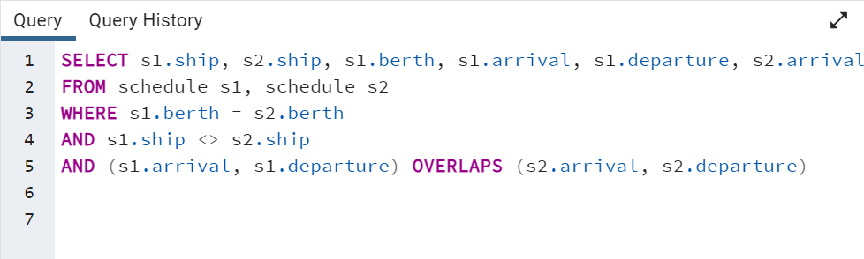
Berth Occupation

Slide 33
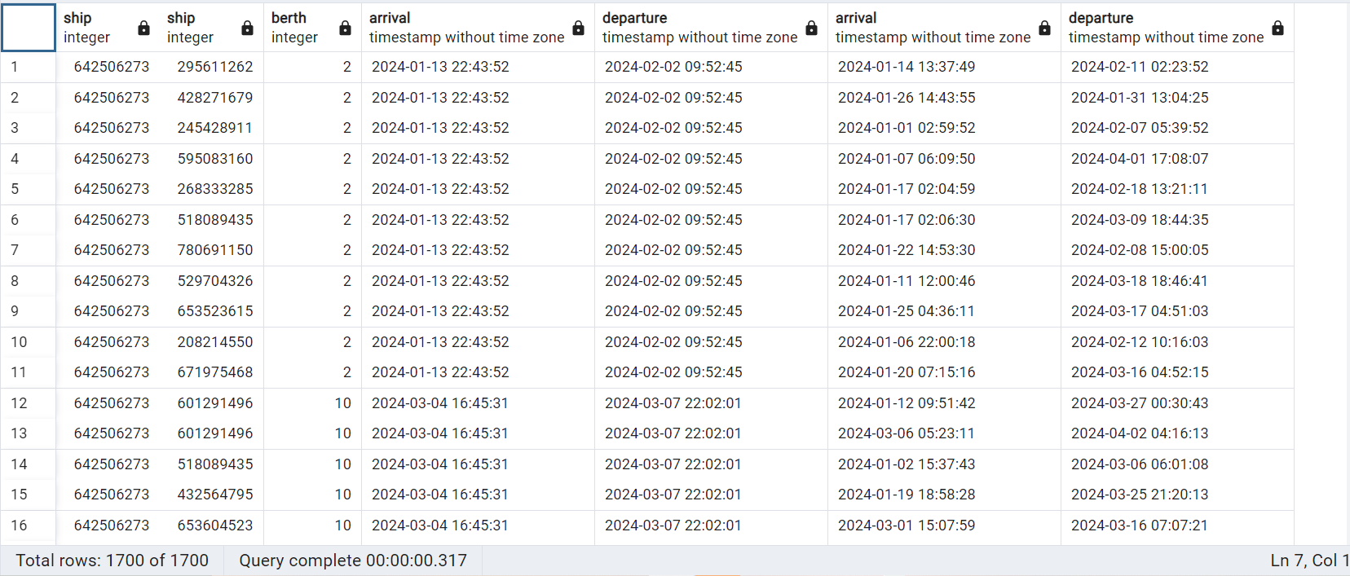
Berth Occupation

Slide 34
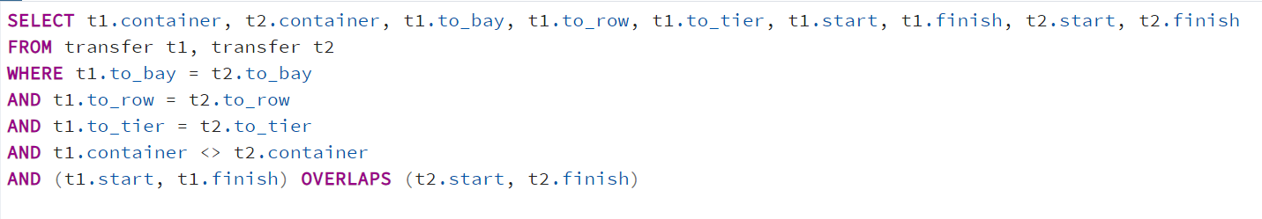
Yard Occupation

Slide 35
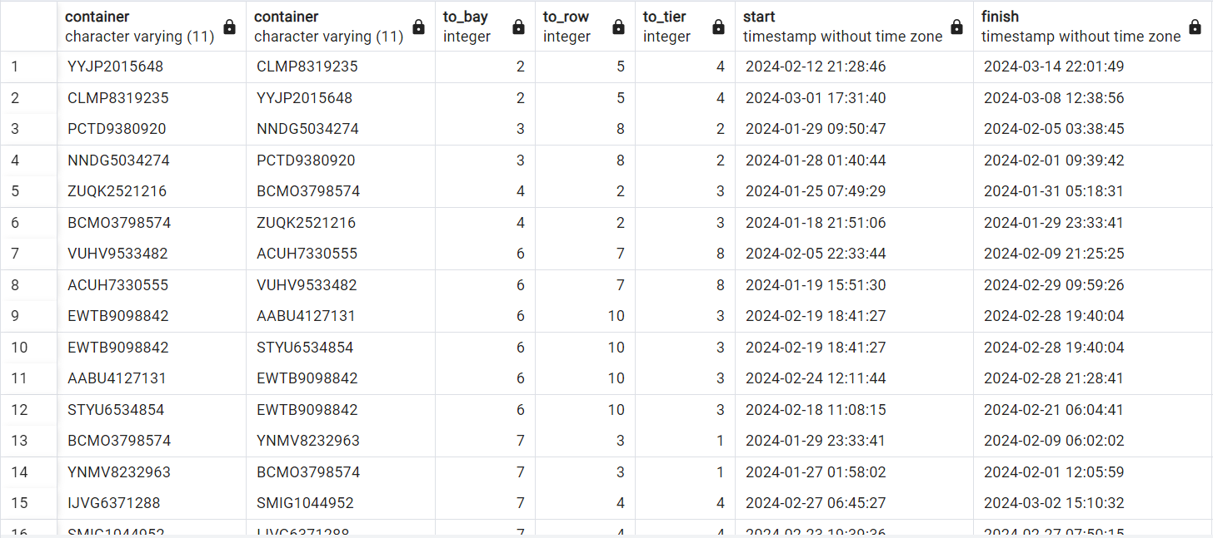
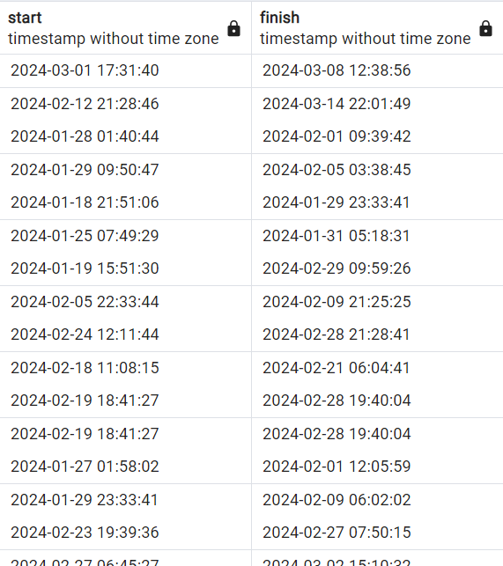
Yard Occupation

Slide 36
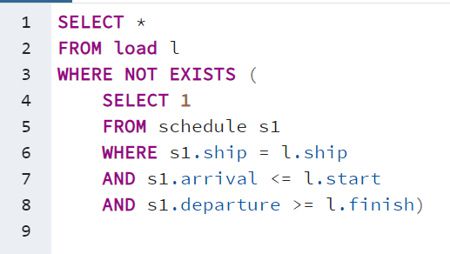
Ship in Berth

Slide 37
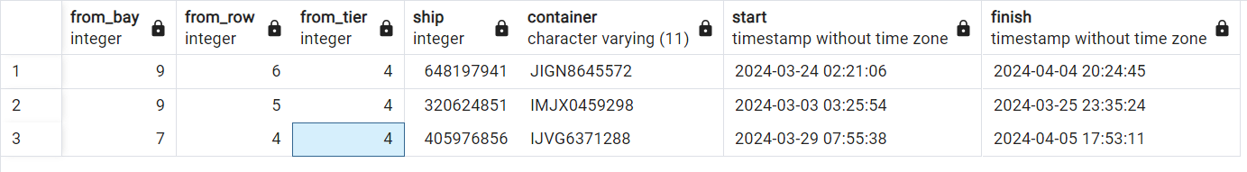
Ship in Berth

Slide 38
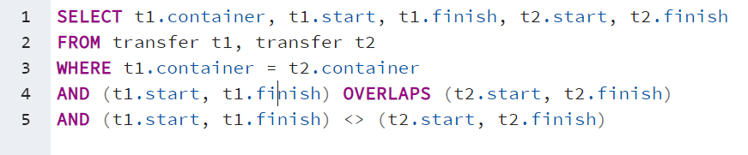
Time Overlap Container

Slide 39
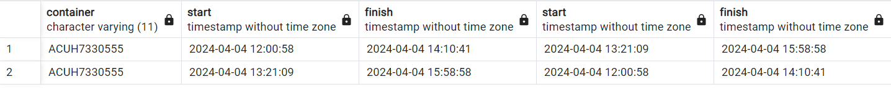
Time Overlap Container

Slide 40
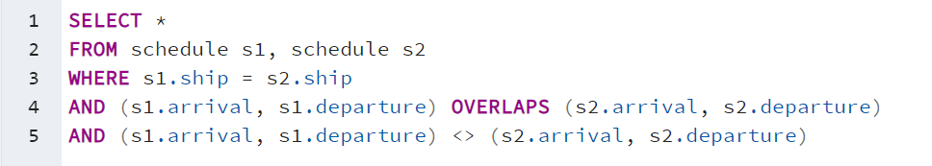
Time Overlap Ship

Slide 41
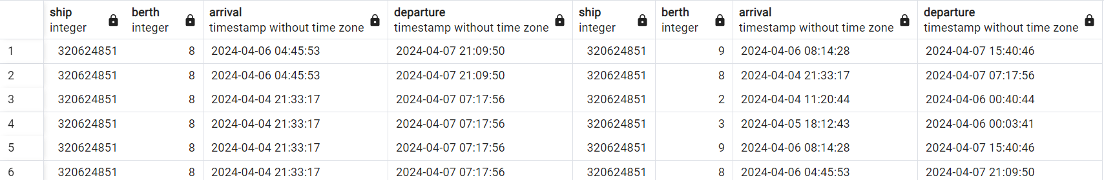
Time Overlap Ship

Slide 42
06
Enforcing Constraints

Slide 43
Enforcing Constraints
Stored Functions
Triggers

Slide 44
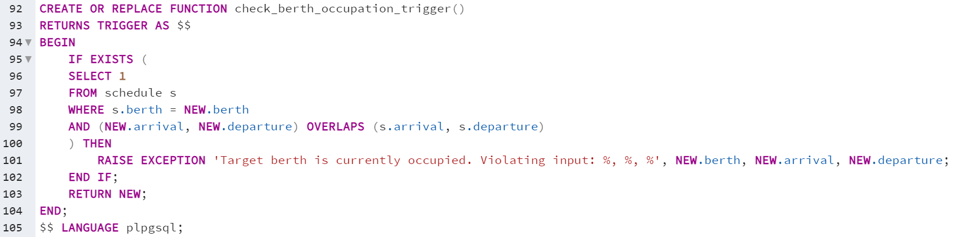
Berth Occupation Check Function

Slide 45
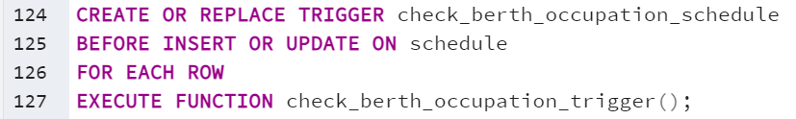
Berth Occupation Trigger

Slide 46
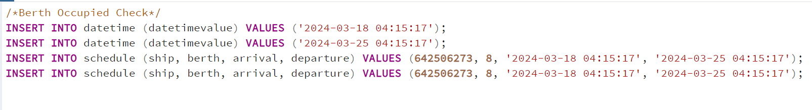
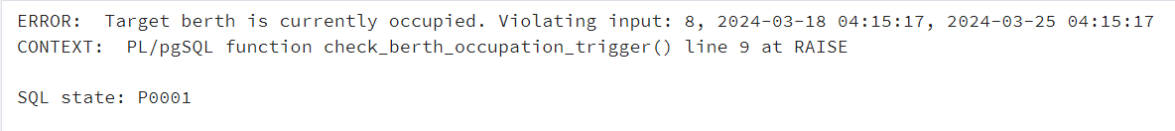
Berth Occupation Enforce Constraint Demo

Slide 47
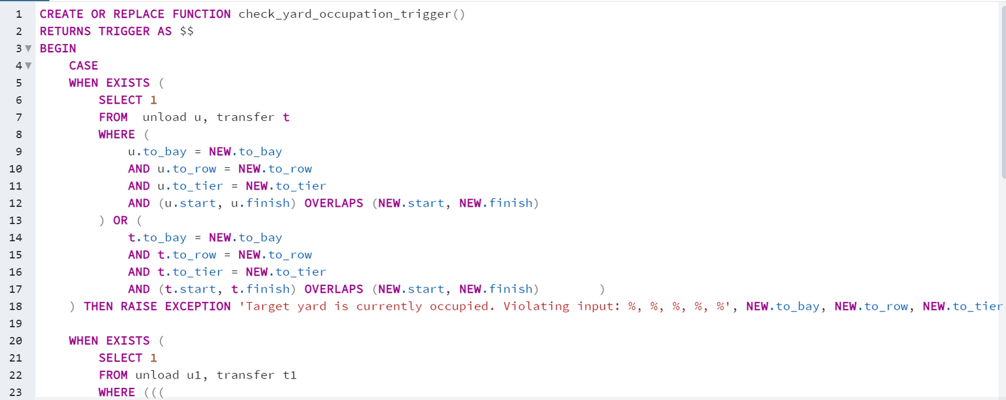
Yard Occupation Check Function

Slide 48
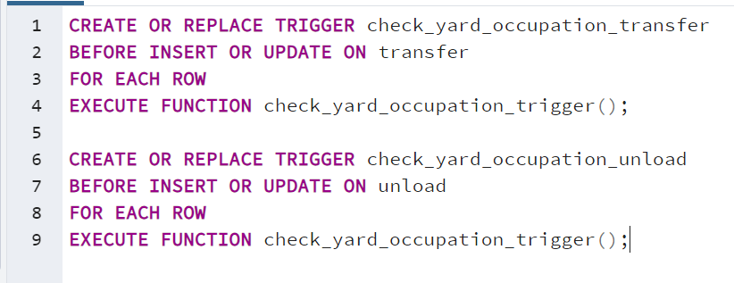
Yard Occupation Trigger

Slide 49
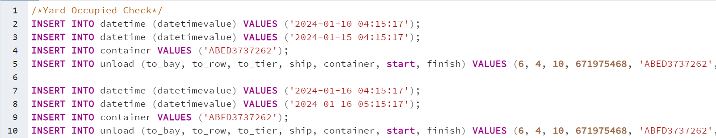
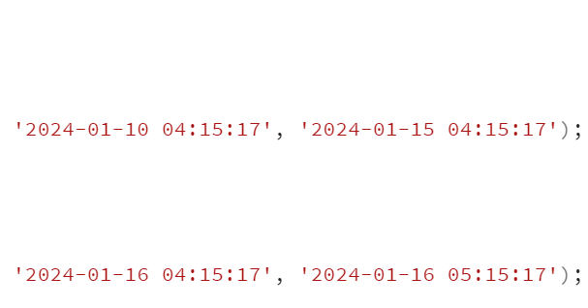
Yard Occupation Enforce Constraint Demo

Slide 50
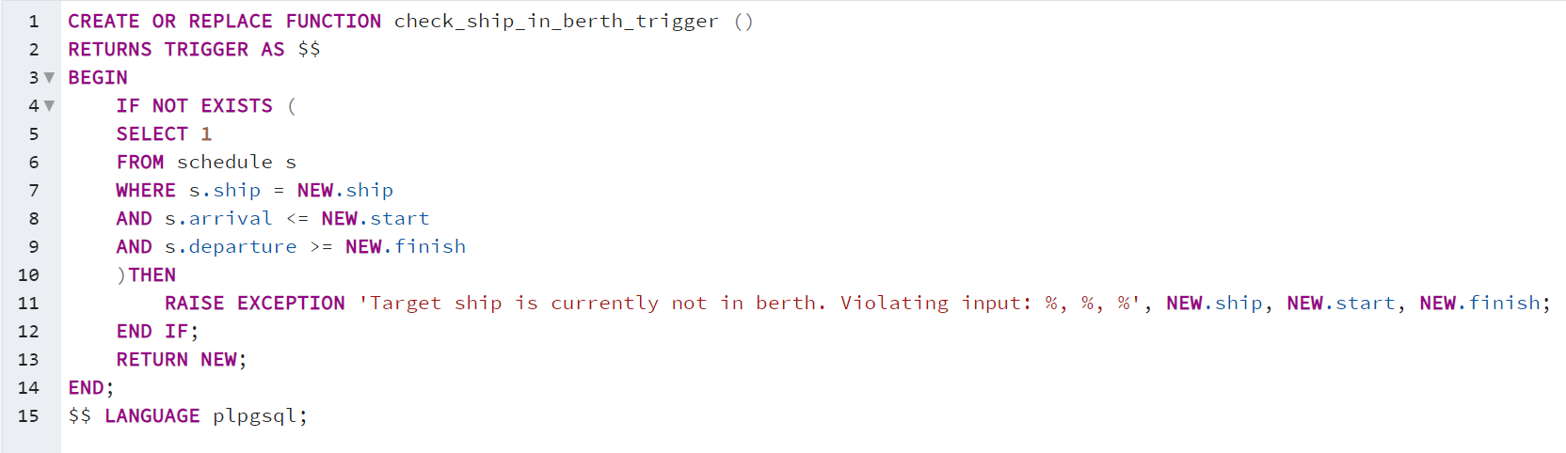
Ship in Berth Check Function

Slide 51

Ship in Berth Trigger

Slide 52

Ship in Berth Enforce Constraint Demo

Slide 53

Time Overlap Container Check Function

Slide 54

Time Overlap Container Trigger

Slide 55

Time Overlap Container Enforce Constraint Demo

Slide 56

Time Overlap Ship Check Function

Slide 57

Time Overlap Ship Trigger

Slide 58
Time Overlap Ship Enforce Constraint Demo

Slide 59


Thank you
CREDITS: This presentation template was created by Slidesgo, and includes icons by Flaticon, and infographics & images by Freepik

